Slide 1




DIGITAL LITERACY
SKILLS
BASIC USERS

Slide 2
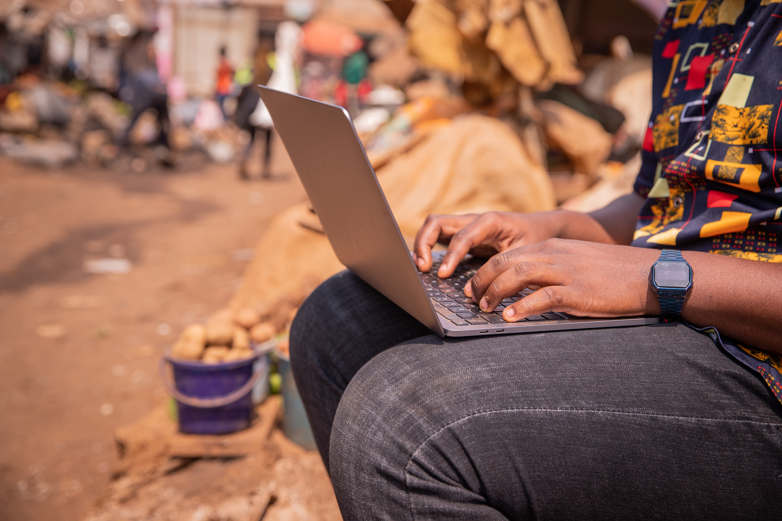
Module 3
Communication
and collaboration

Slide 3

3
Unit 3: Engaging in citizenship through digital technologies

Slide 4
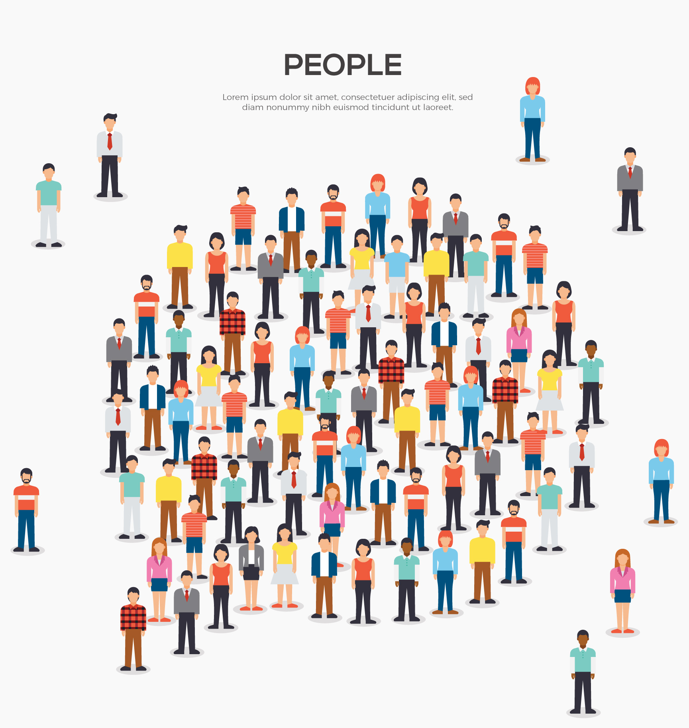
Basic concepts of digital citizenship
E-Safety: Includes internet privacy and how behaviour can add to healthy interactions.
Reputation: How we are perceived online.
Relationships: Using technology to interact with others.
Ethics: How to act in an ethical way online.

Slide 5
Digital citizenship
A good citizen |  | A good digital citizen
Advocates for equal human rights |  | Advocates for equal digital rights for all
Treats others with respect |  | Seeks to understand all perspectives
Does not steal or damage others’ property |  | Respects digital privacy, intellectual property, and other rights of people online
Communicates clearly respectfully and with empathy |  | Communicates and acts with empathy for others’ humanity via digital channels
Speaks honestly and does not repeat unsubstantiated rumours |  | Applies critical thinking to all online sources, including fake news
Protects self and others from harm |  | Is mindful of physical, emotional, and mental health while using digital tools.
Projects a positive self-image |  | Understands the permanence of the digital world and proactively manages their digital identity

Slide 6

Online training and eLearning
Online teaching and training services take many forms.
Some advertise the services they offer at their premises, whereas others offer online training and e-learning.

Slide 7
Skills to practice
Use digital technologies to interact with services (as school or education).
Choose a topic that interests you, e.g., ‘Boxy braids’ or ‘long and short passes in football’.
Open YouTube and type in your search words.
Select a video that interests you.
Use the link provided for Khan Academy (https://www.khanacademy.org/)
Open the website and sign up.
Select a lesson that interests you.

Slide 8
All back covers should include
contact information of the section
producing the work.
© United Nations Children’s Fund (UNICEF) [month and year of publication]

